Slide 1
May 30th

Slide 2
Agenda
Extended Spectrogram Cargo ships
Range and Speed over Time
SPDF and Spectrogram at a selected range
SPDF Different Location, Same MMSI

Slide 3
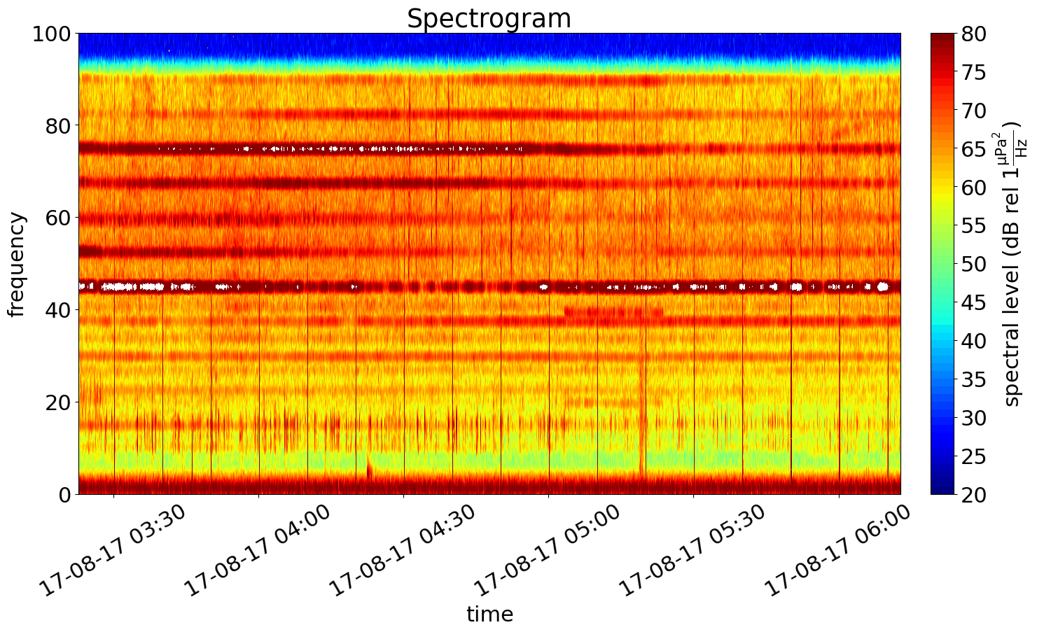
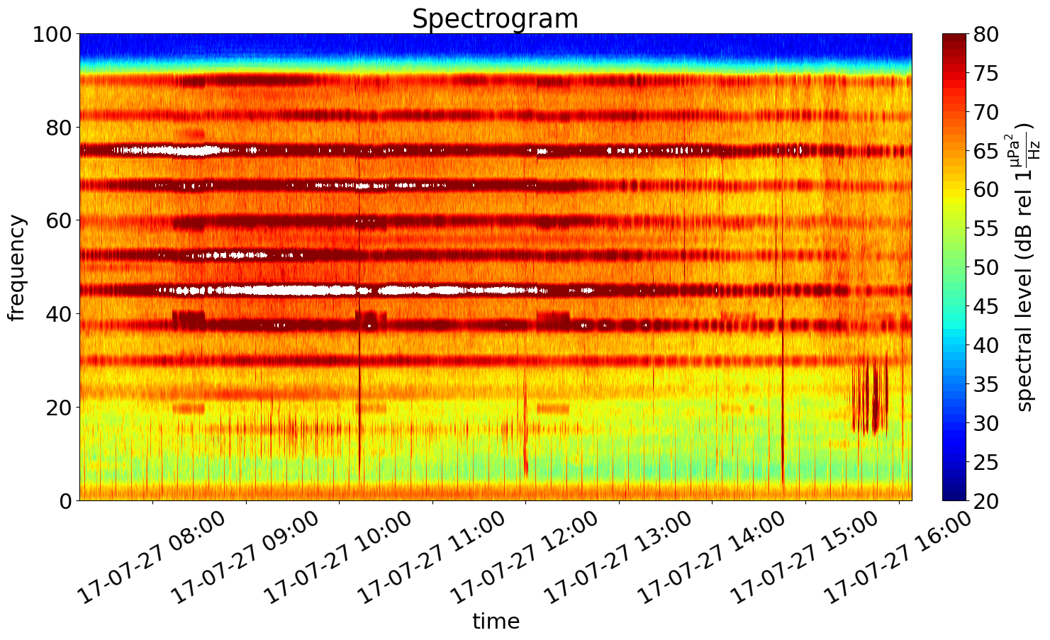
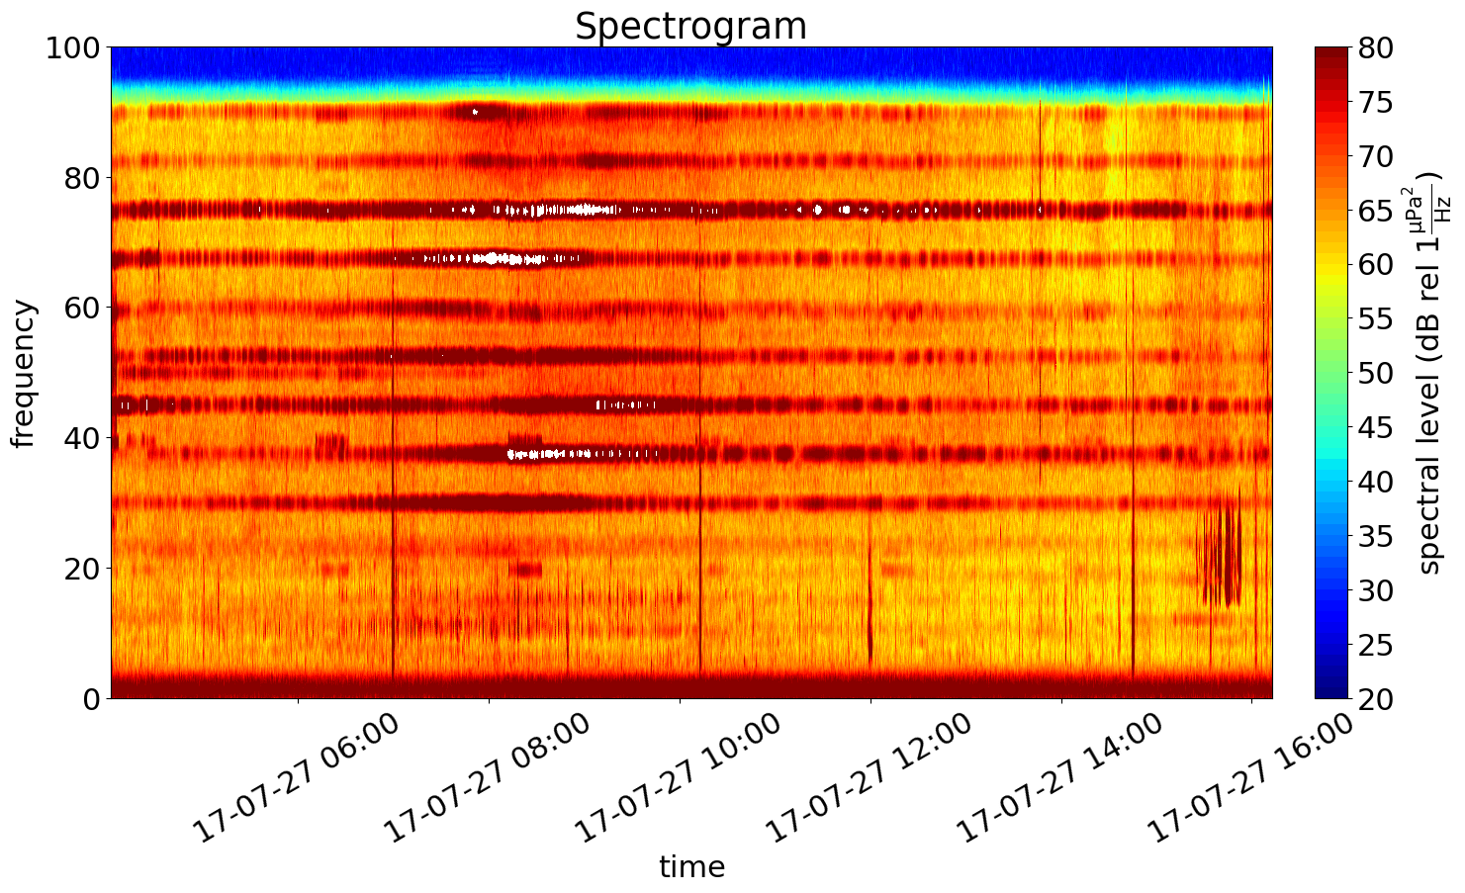
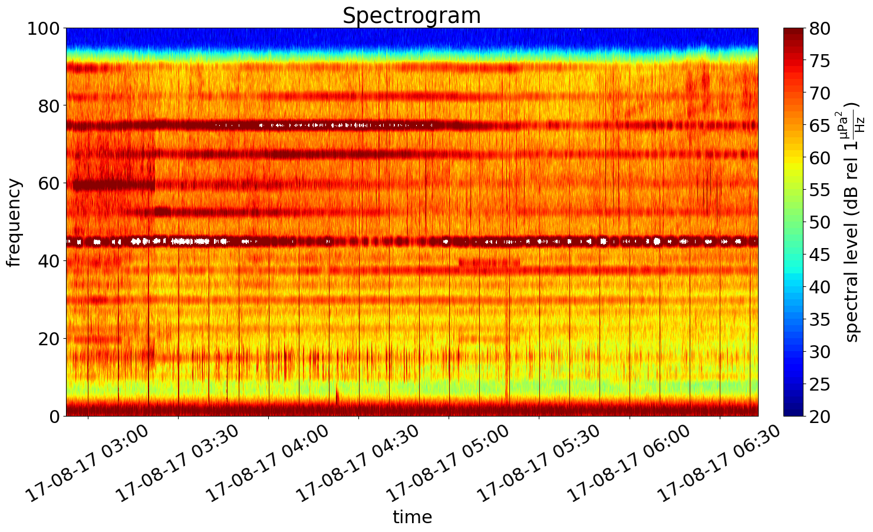

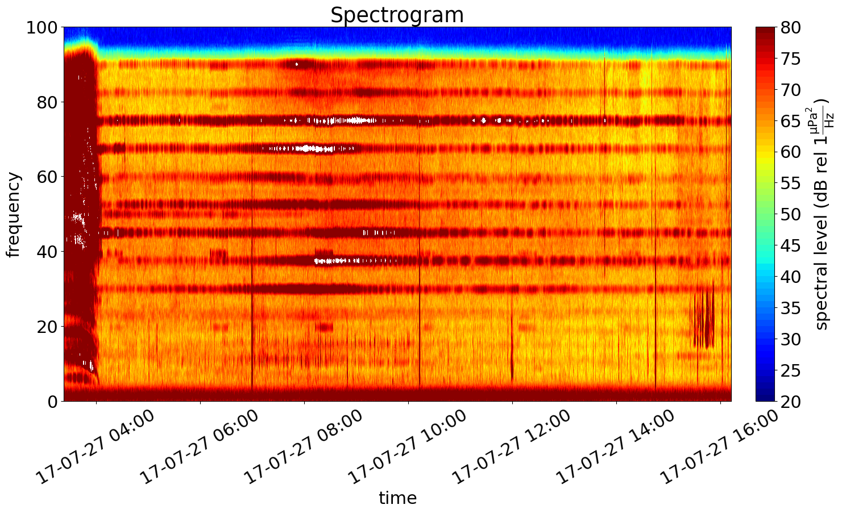
MMSI 356190000 Cargo Vessel
Original
Extended
AB
EC
CC

Slide 4
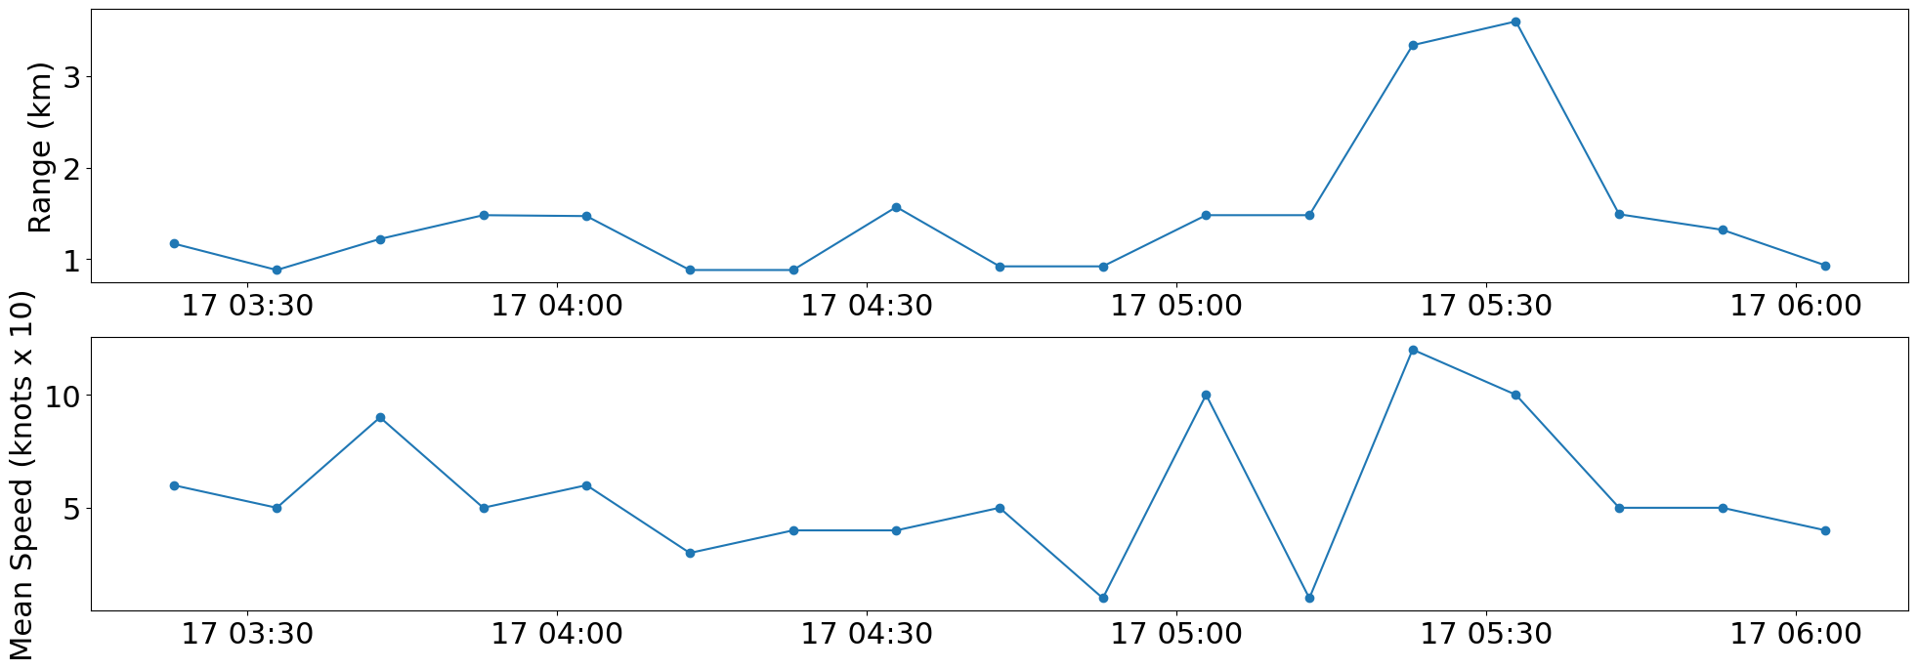

Slide 5
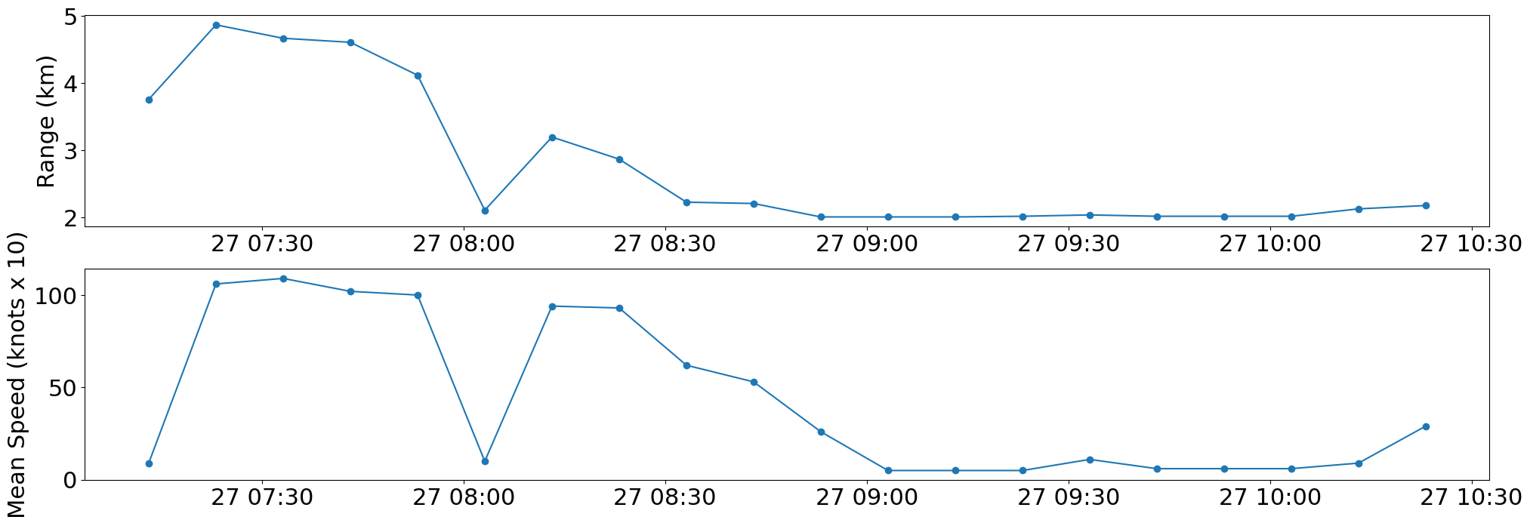
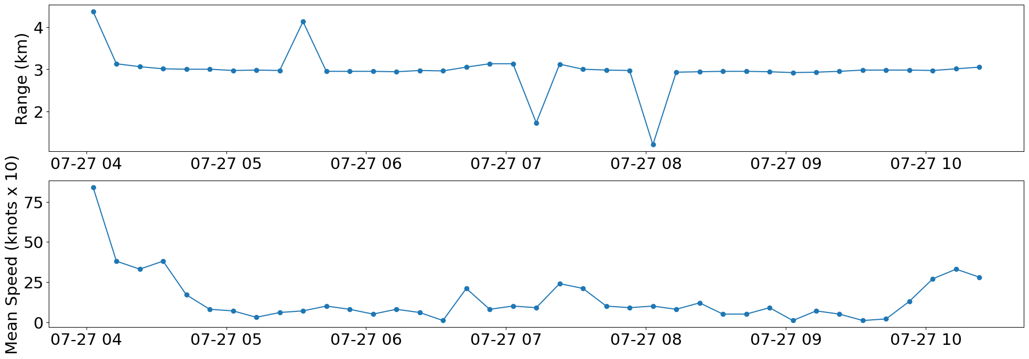
MMSI 356190000 Cargo Vessel
AB
EC
CC

Slide 6
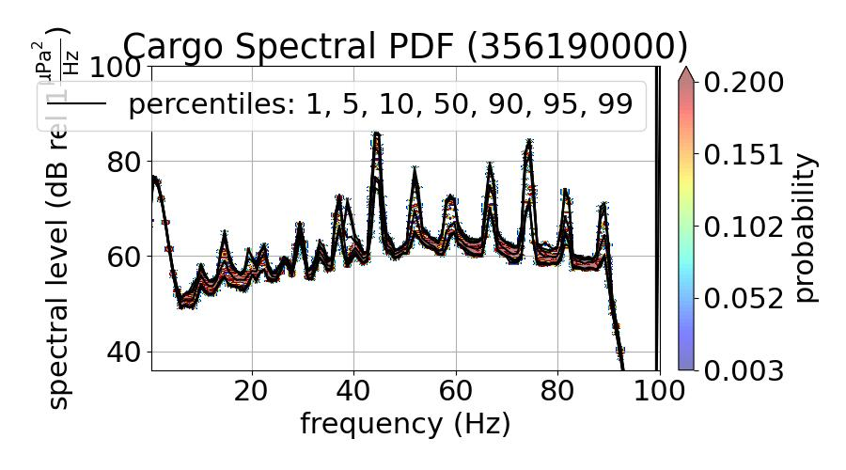
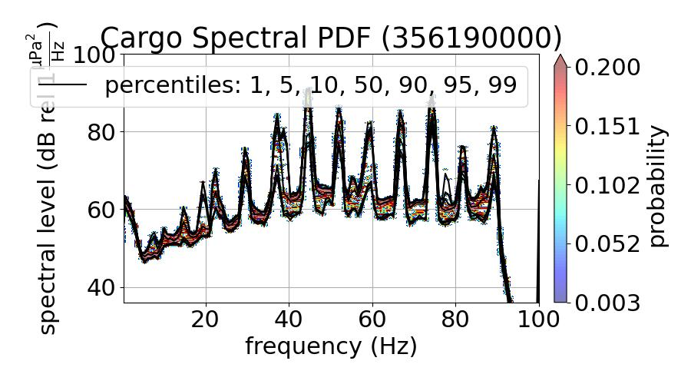
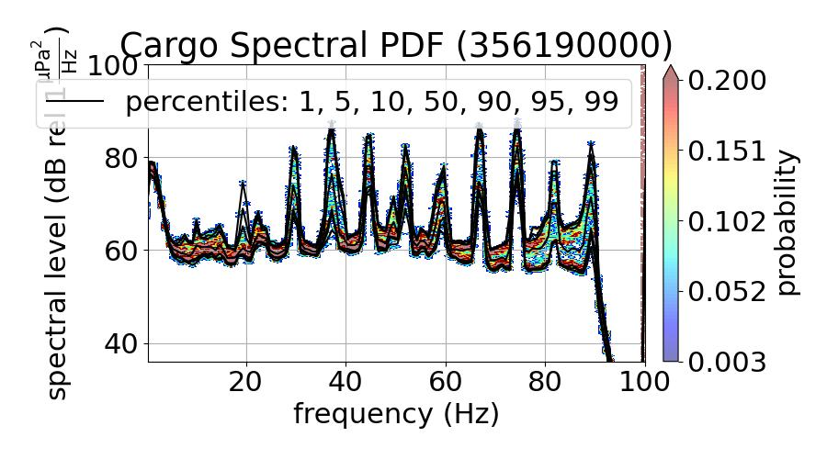
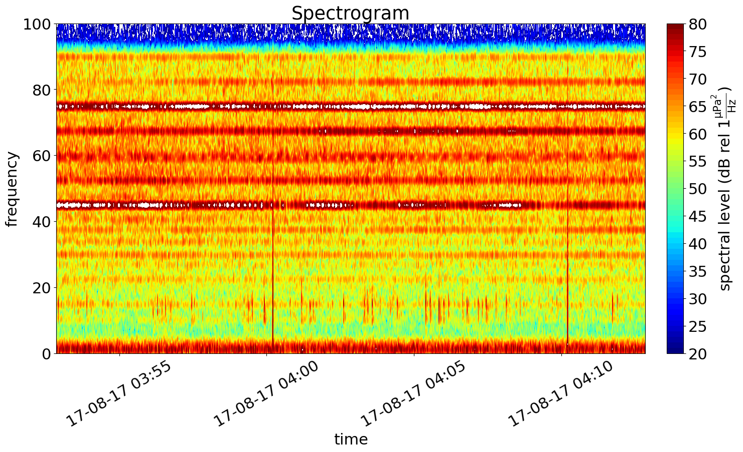
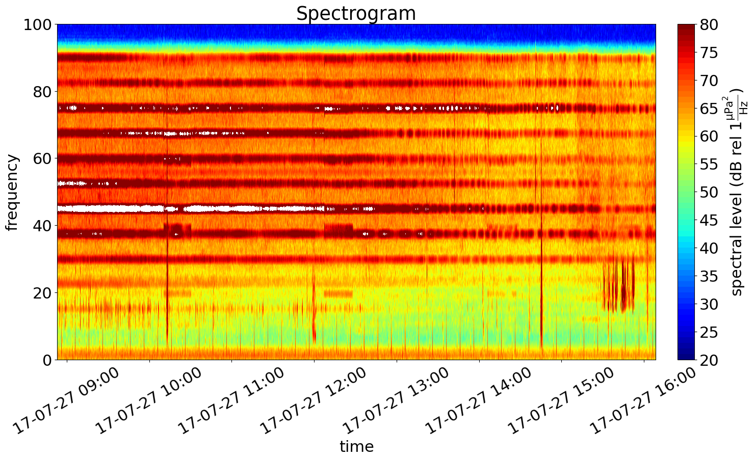
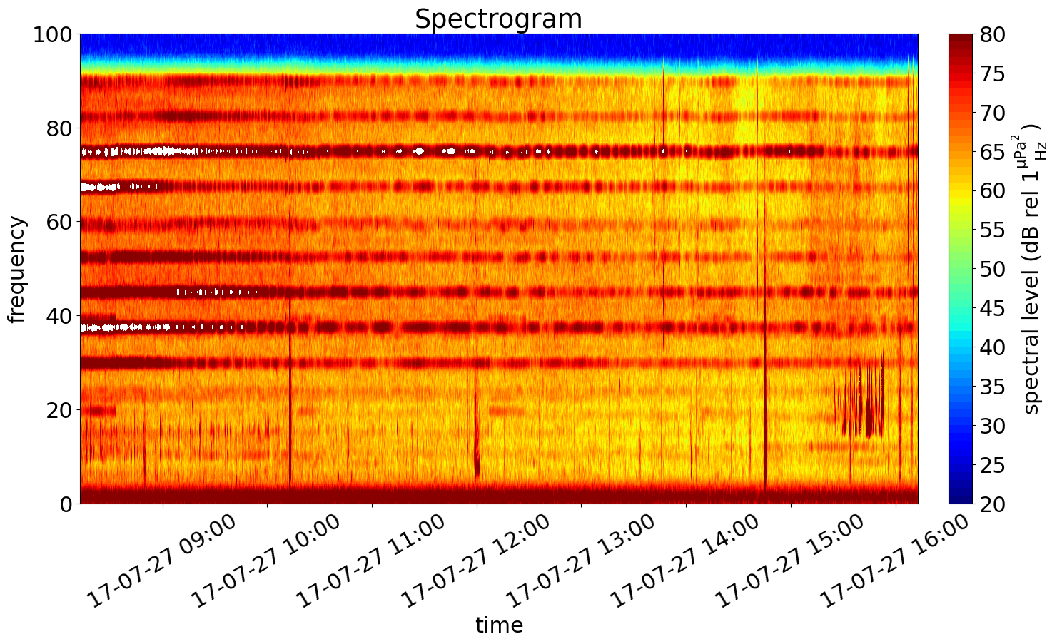
MMSI 356190000 Cargo Vessel
SPDF
Spectrogram
AB
Range: 1.45-1.57km
EC
Range: 1.95-2.05km
CC
Range: 2.95-3.05km

Slide 7
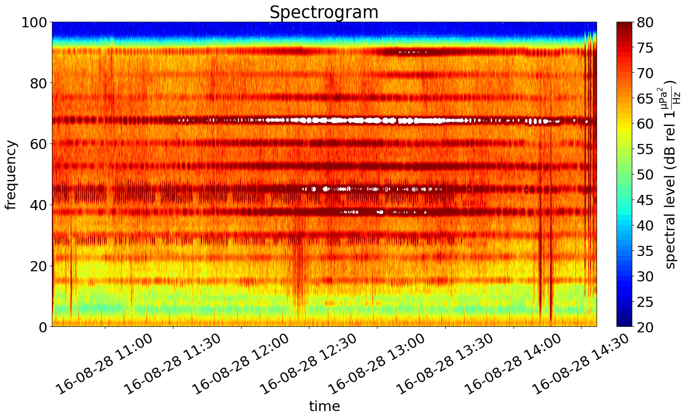
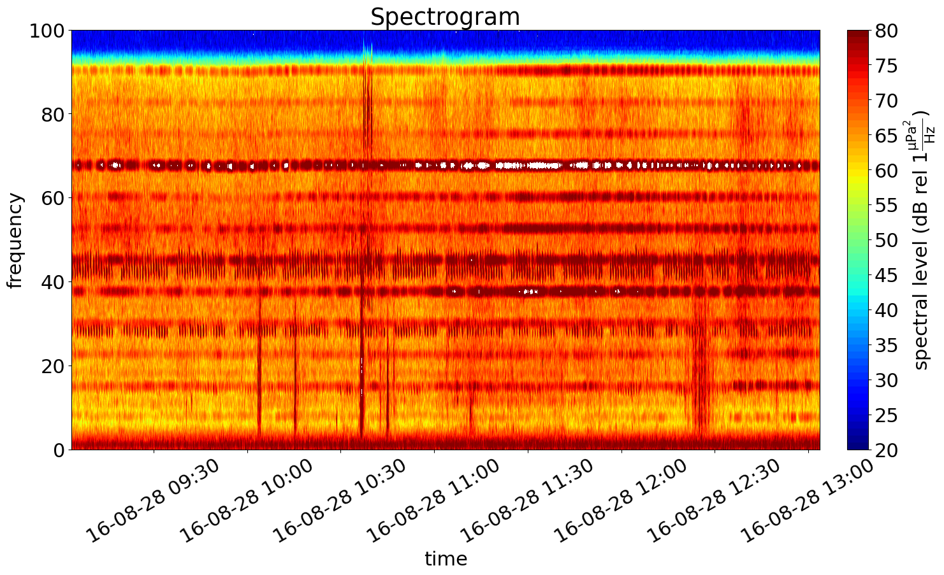
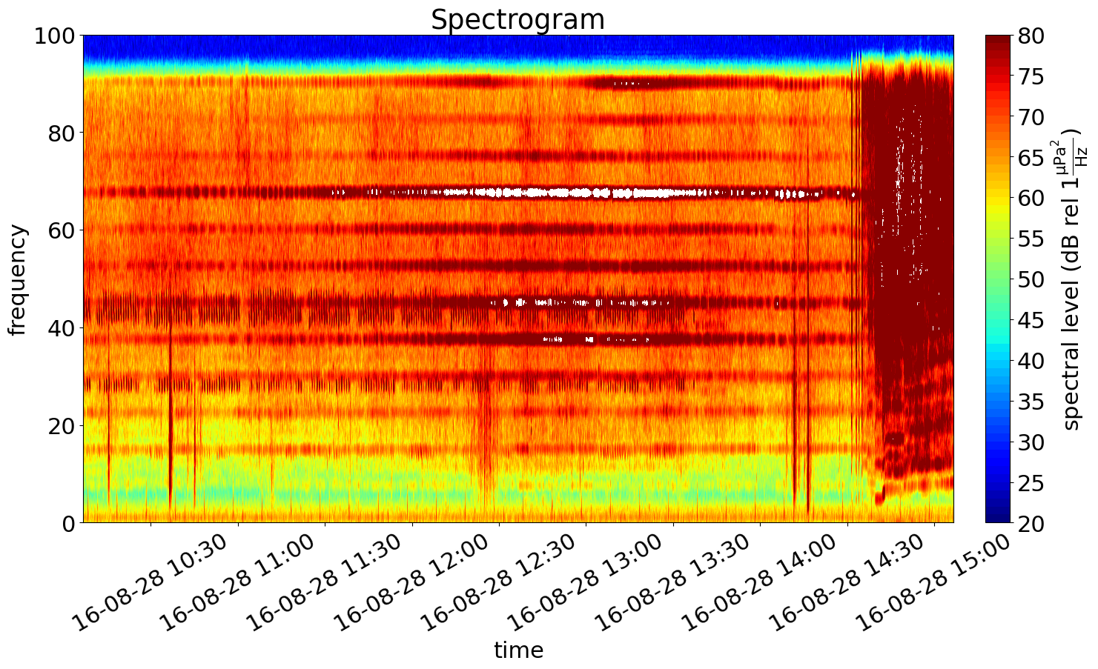
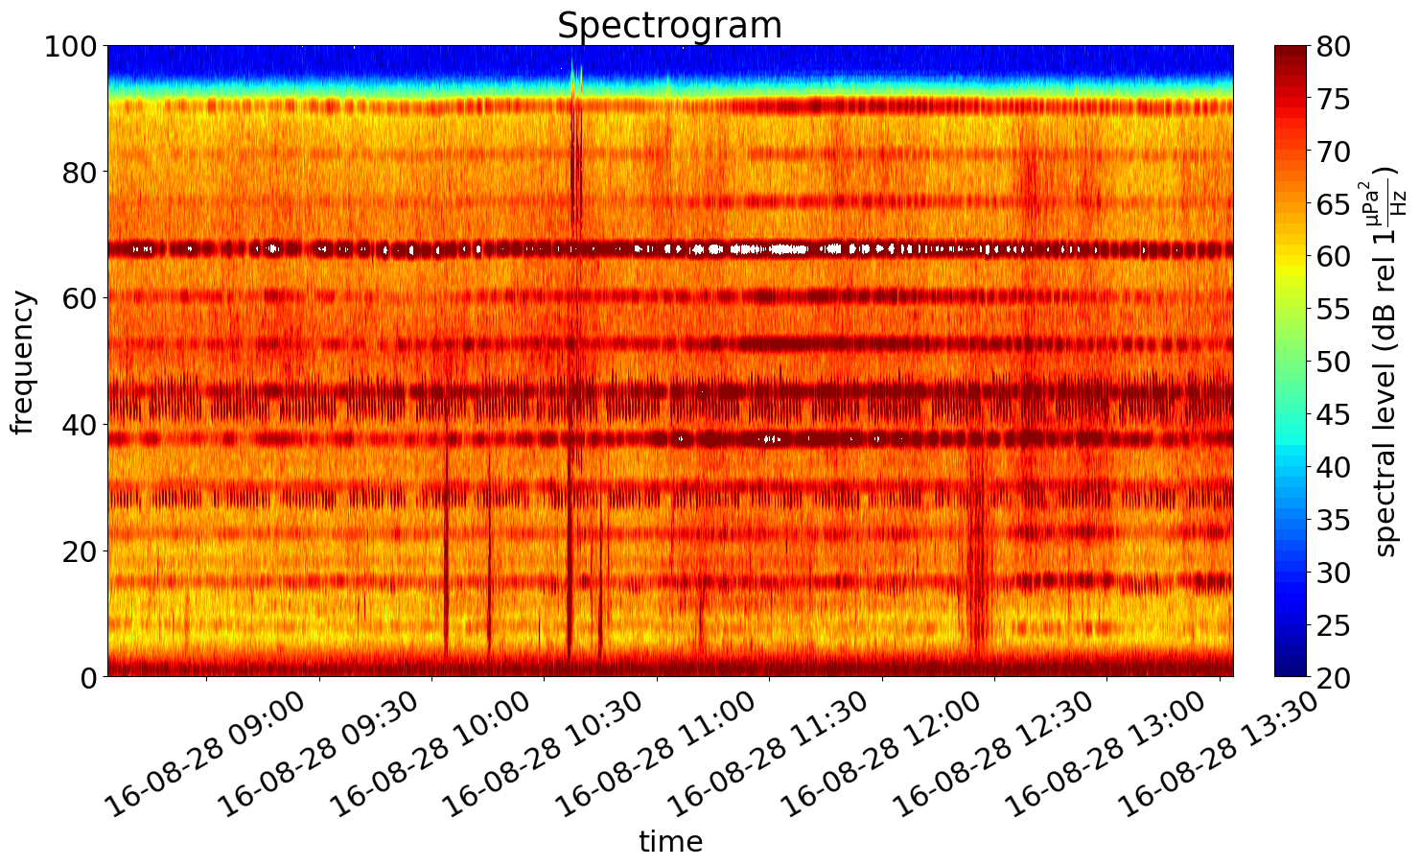
MMSI 372305000 Cargo Vessel
Original
Extended
EC
CC

Slide 8
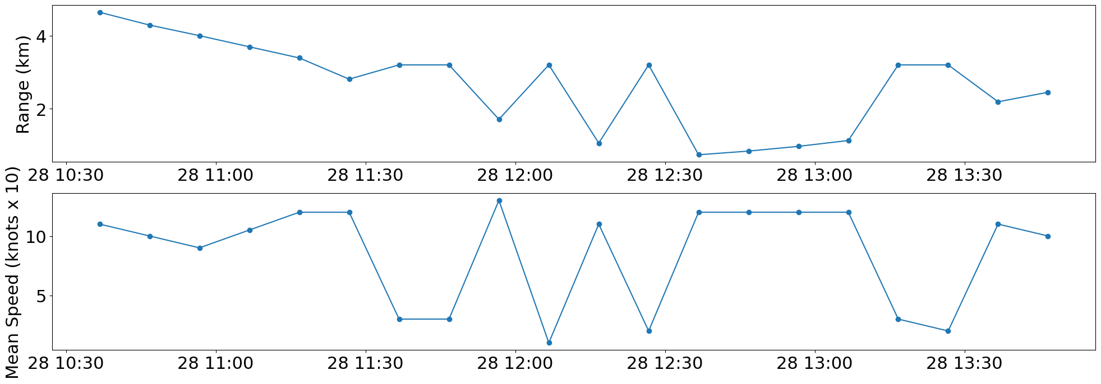
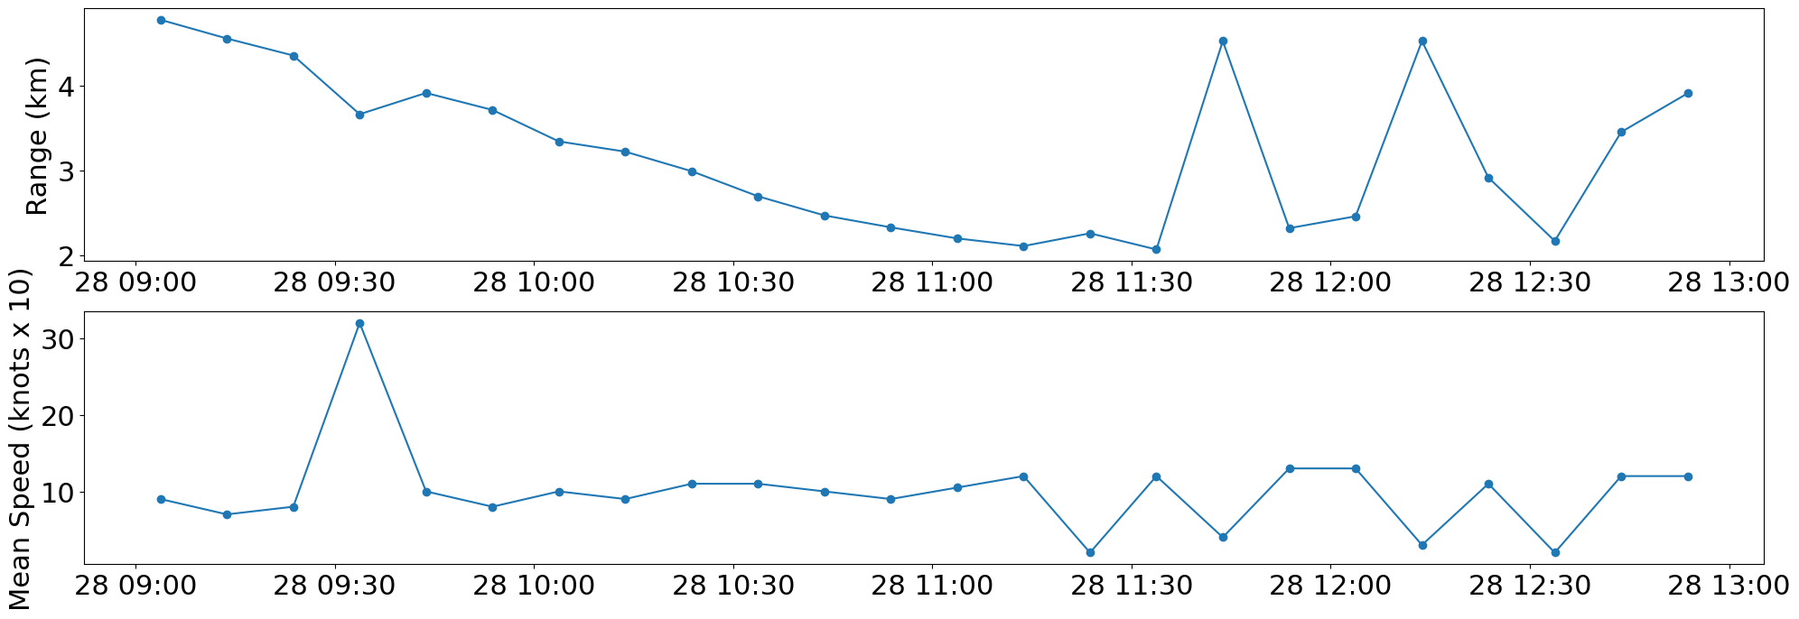
MMSI 372305000 Cargo Vessel
EC
CC

Slide 9
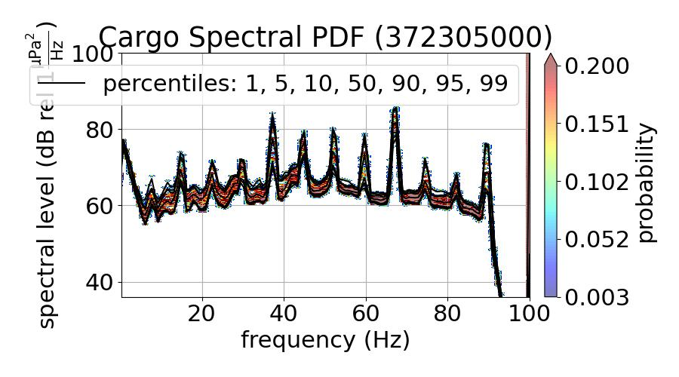
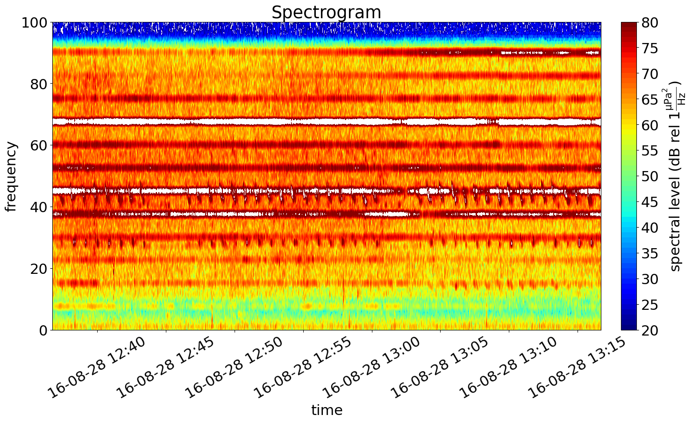
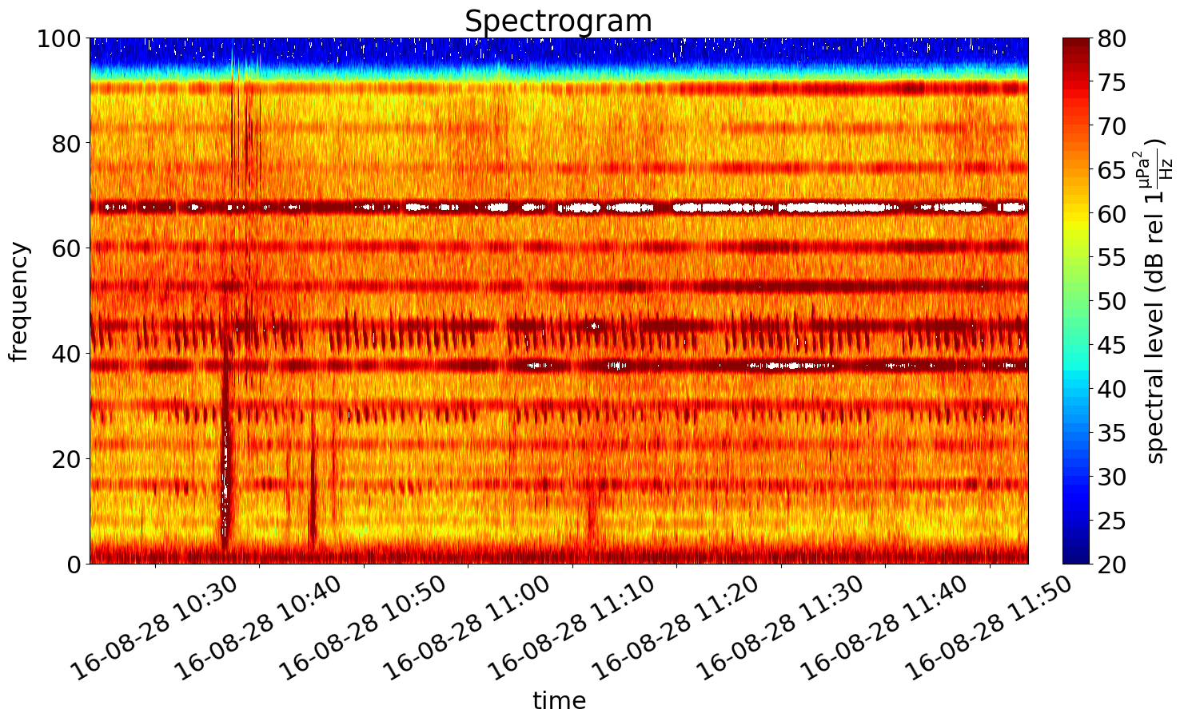
MMSI 372305000 Cargo Vessel
SPDF
Unable to find proper EC files
Spectrogram
EC
Range: 0. 5-1.15km
CC
Range: 2-3km

